Slide 1
This time: learning from examples
Learning agents
Inductive learning
Classification and support vector machines (SVM)
Decision tree learning

Slide 2
What is learning?
“Learning denotes changes in a system that ... enable a system to do the same task more efficiently the next time.” –Herbert Simon
“Learning is constructing or modifying representations of what is being experienced.” –Ryszard Michalski
“Learning is making useful changes in our minds.” –Marvin Minsky

Slide 3
Why study learning?
Understand and improve efficiency of human learning
Use to improve methods for teaching and tutoring people (e.g., better computer-aided instruction)
Discover new things or structure previously unknown
Examples: data mining, scientific discovery
Fill in skeletal or incomplete specifications about a domain
Large, complex AI systems can’t be completely built by hand and require dynamic updating to incorporate new information
Learning new characteristics expands the domain or expertise and lessens the “brittleness” of the system
Build agents that can adapt to users, other agents, and their environment

Slide 4
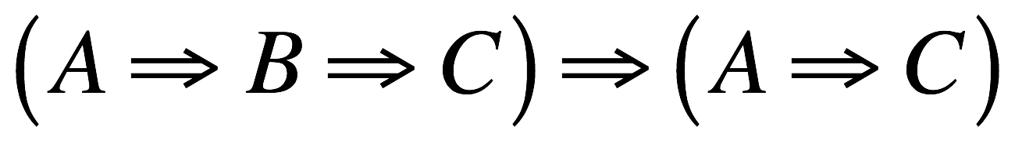
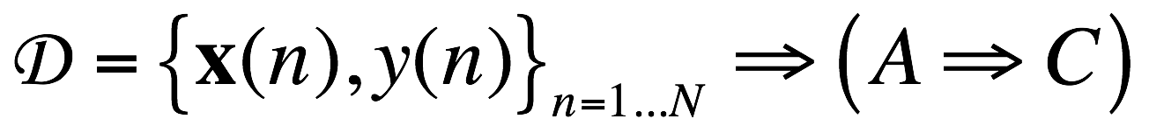
Two types of learning in AI
Deductive: Deduce rules/facts from already known rules/facts. (We have already dealt with this)
Inductive: Learn new rules/facts from a data set D.
We will be dealing with the latter, inductive learning, now

Slide 5
Learning
Learning is essential for unknown environments,
i.e., when designer lacks omniscience
Learning is useful as a system construction method,
i.e., expose the agent to reality rather than trying to write it down
Learning modifies the agent's decision mechanisms to improve performance

Slide 6
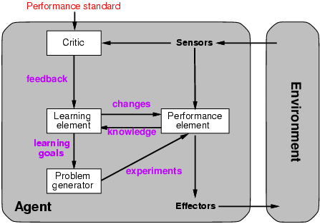
Learning agents

Slide 7
Learning element
Design of a learning element is affected by
Which components of the performance element are to be learned
What feedback is available to learn these components
What representation is used for the components
Type of feedback:
Supervised learning: correct answers for each example
Unsupervised learning: correct answers not given
Reinforcement learning: occasional rewards

Slide 8
Inductive learning
Simplest form: learn a function from examples
f is the target function
An example is a pair (x, f(x))
Problem: find a hypothesis h
such that h ≈ f
given a training set of examples
(This is a highly simplified model of real learning:
Ignores prior knowledge
Assumes examples are given)

Slide 9
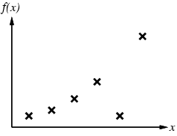
Inductive learning method
Construct/adjust h to agree with f on training set
(h is consistent if it agrees with f on all examples)
E.g., curve fitting:

Slide 10
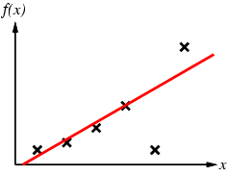
Inductive learning method
Construct/adjust h to agree with f on training set
(h is consistent if it agrees with f on all examples)
E.g., curve fitting:

Slide 11
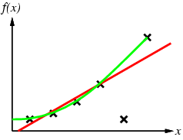
Inductive learning method
Construct/adjust h to agree with f on training set
(h is consistent if it agrees with f on all examples)
E.g., curve fitting:

Slide 12
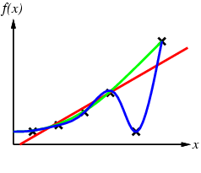
Inductive learning method
Construct/adjust h to agree with f on training set
(h is consistent if it agrees with f on all examples)
E.g., curve fitting:

Slide 13
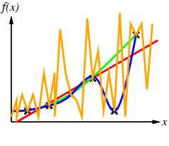
Inductive learning method
Construct/adjust h to agree with f on training set
(h is consistent if it agrees with f on all examples)
E.g., curve fitting:

Slide 14
Inductive learning method
Construct/adjust h to agree with f on training set
(h is consistent if it agrees with f on all examples)
E.g., curve fitting:
Ockham’s razor: prefer the simplest hypothesis consistent with data

Slide 15
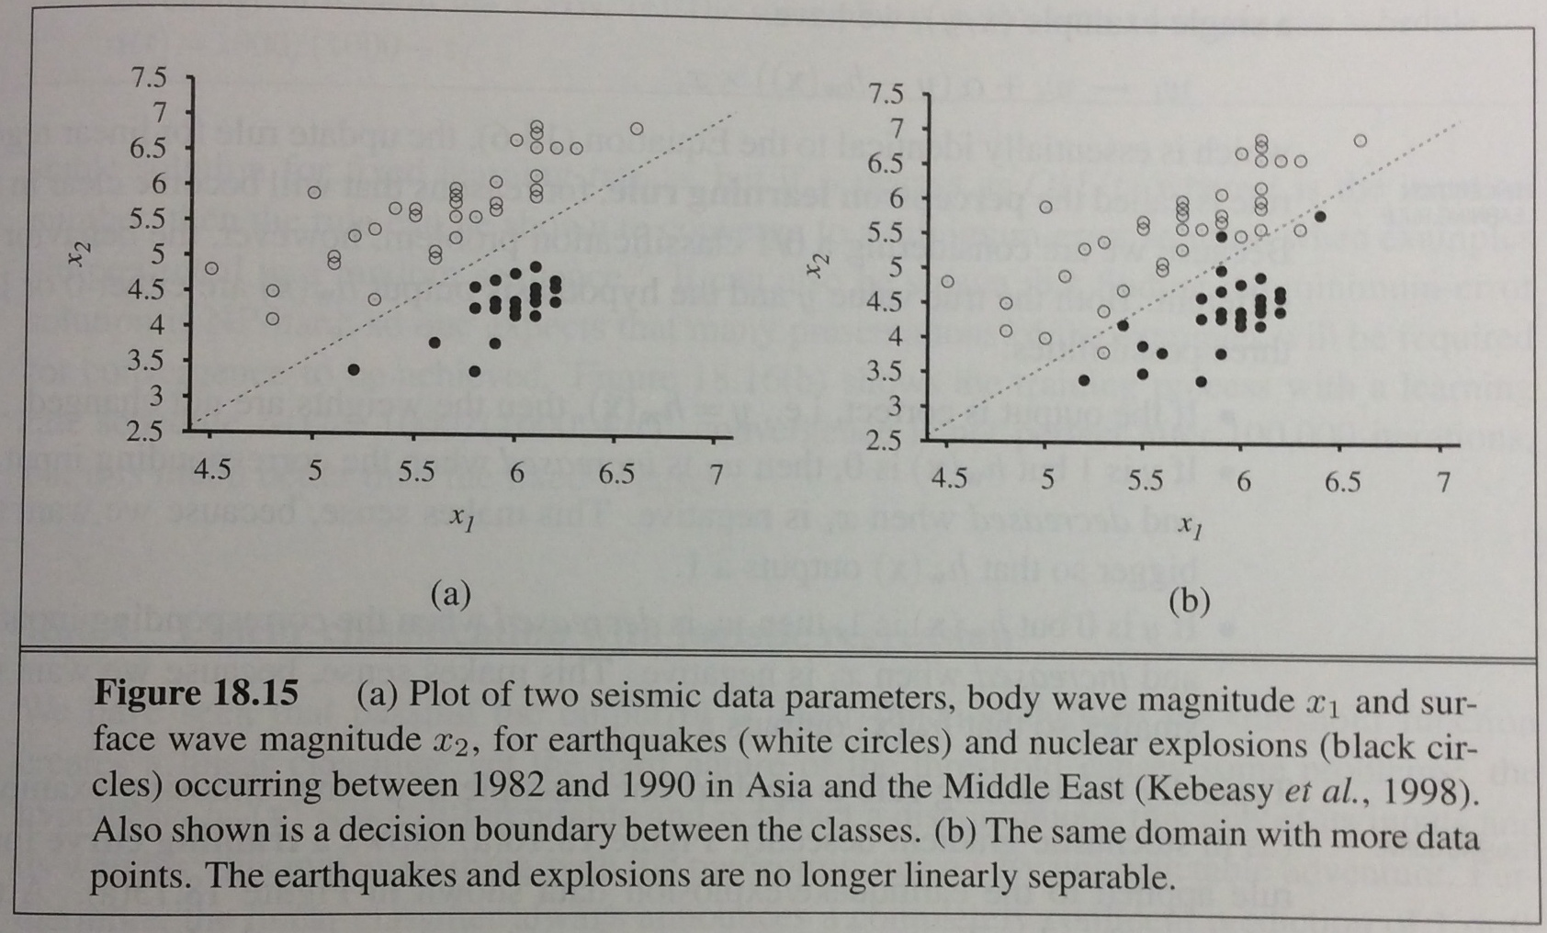
Learning to classify
In many problems we want to learn how to classify data into one of several possible categories.
E.g., face recognition, etc. Here earthquake vs nuclear explosion:

Slide 16
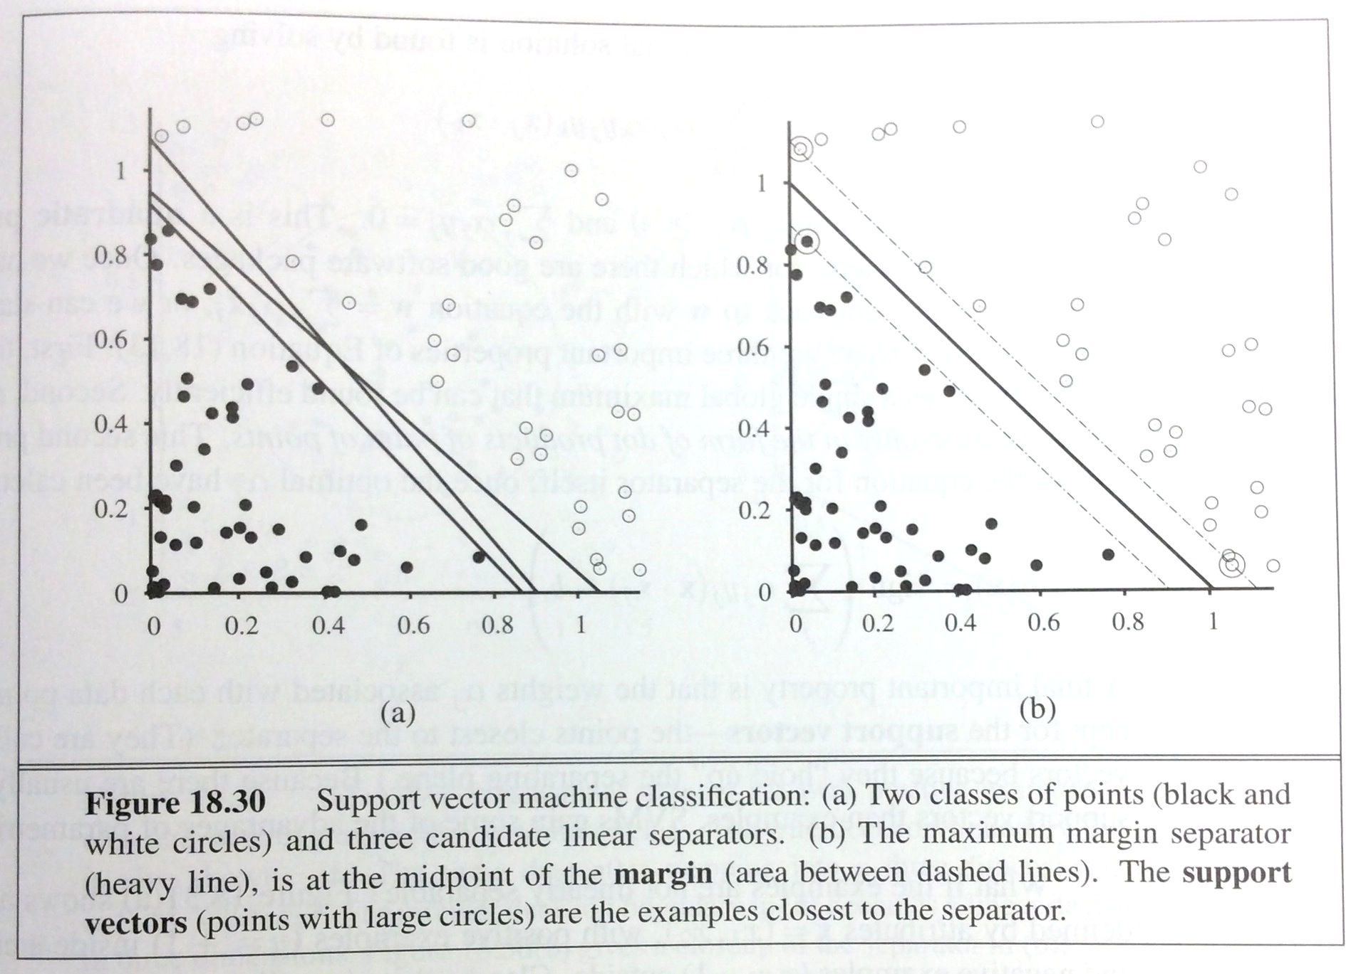
Problem: how to best draw the line?
Many methods exist. One of the most popular ones is the support vector machine (SVM): Find the maximum margin separator, i.e., the one that is as far as possible from any example point.

Slide 17
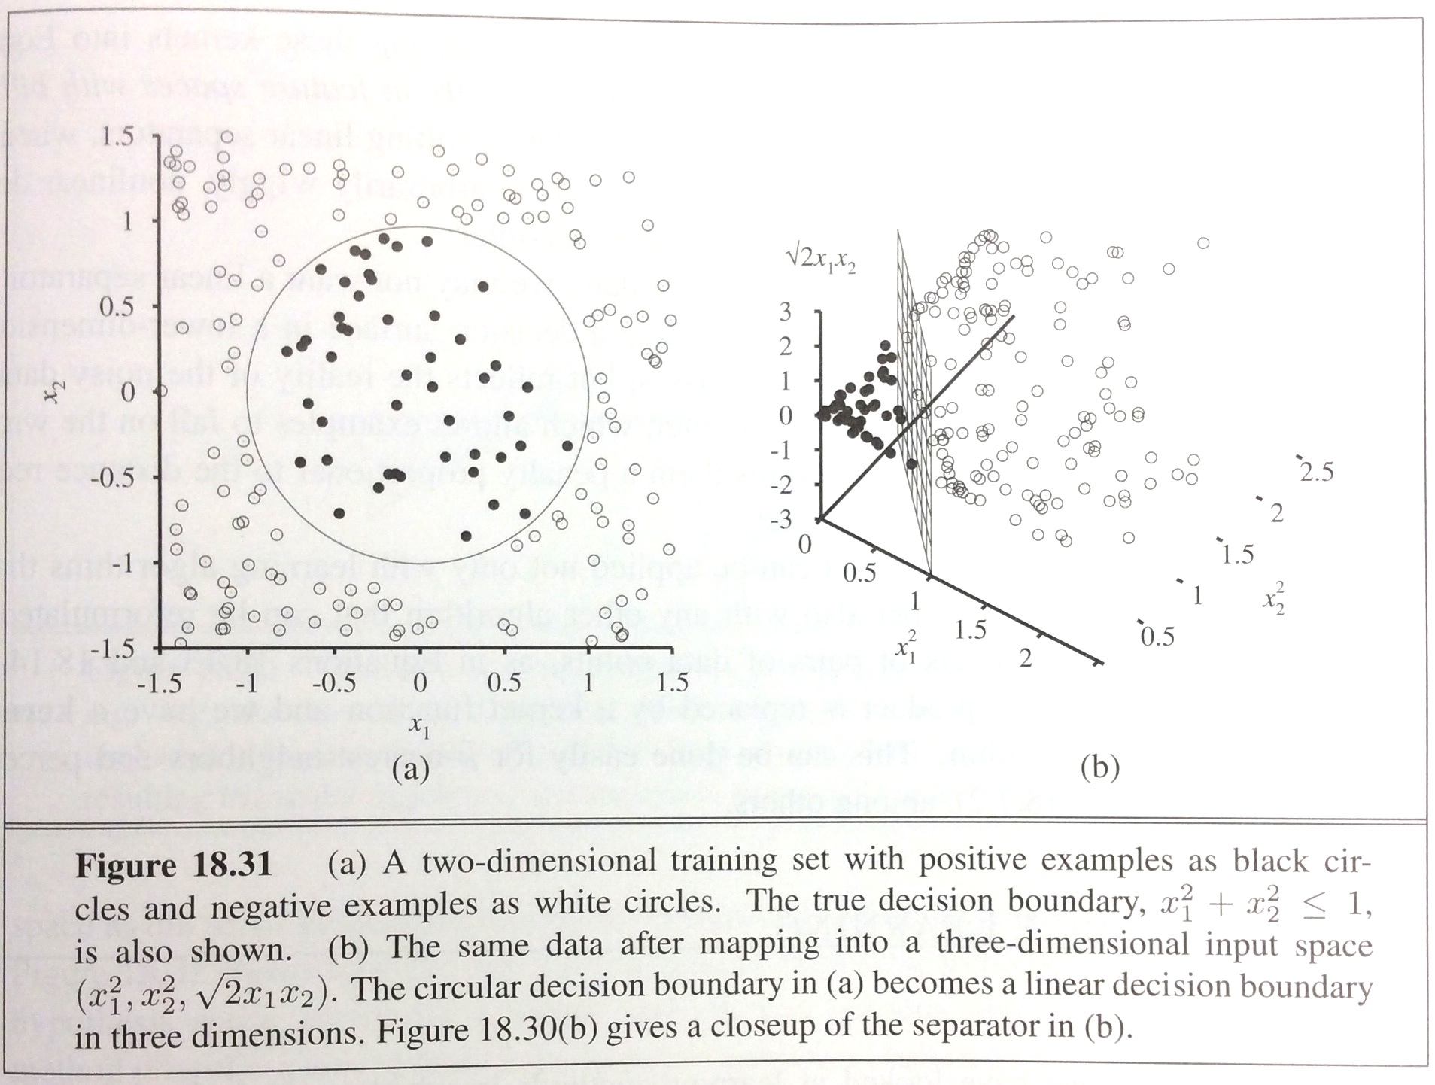
Non-linear separability and SVM
SVM can handle data that is not linearly separable using the so-called “kernel trick”: embed the data into a higher-dimensional space, in which it is linearly separable.

Slide 18
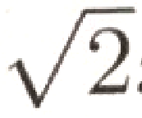
Non-linear separability and SVM
Kernel: remaps from original 2 dimensions x1 and x2 to
3 new dimensions: f1 = x1^2, f2 = x2^2, f3 = .x1.x2
(see textbook for details on how those new dimensions were chosen)

Slide 19
Learning decision trees
In some other problems, a single A vs. B classification is not sufficient.
For example:
Problem: decide whether to wait for a table at a restaurant, based on the following attributes:
Alternate: is there an alternative restaurant nearby?
Bar: is there a comfortable bar area to wait in?
Fri/Sat: is today Friday or Saturday?
Hungry: are we hungry?
Patrons: number of people in the restaurant (None, Some, Full)
Price: price range ($, $$, $$$)
Raining: is it raining outside?
Reservation: have we made a reservation?
Type: kind of restaurant (French, Italian, Thai, Burger)
WaitEstimate: estimated waiting time (0-10, 10-30, 30-60, >60)

Slide 20
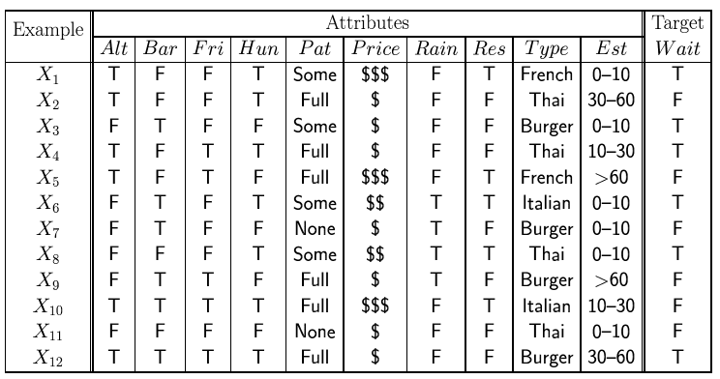
Attribute-based representations
Examples described by attribute values (Boolean, discrete, continuous)
E.g., situations where I will/won't wait for a table:
Classification of examples is positive (T) or negative (F)

Slide 21
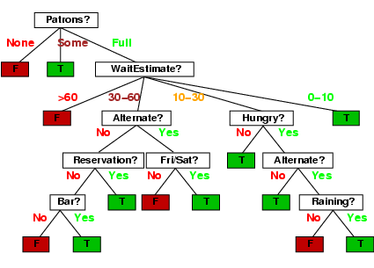
Decision trees
One possible representation for hypotheses
E.g., here is the “true” (designed manually by thinking about all cases) tree for deciding whether to wait:
Could we learn this tree from examples instead of designing it by hand?

Slide 22
Inductive learning of decision tree
Simplest: Construct a decision tree with one leaf for every example = memory based learning. Not very good generalization.
Advanced: Split on each variable so that the purity of each split increases (i.e. either only yes or only no)
Purity measured,e.g, with entropy

Slide 23
Inductive learning of decision tree
Simplest: Construct a decision tree with one leaf for every example = memory based learning. Not very good generalization.
Advanced: Split on each variable so that the purity of each split increases (i.e. either only yes or only no)
Purity measured,e.g, with entropy

Slide 24
Inductive learning of decision tree
Simplest: Construct a decision tree with one leaf for every example = memory based learning. Not very good generalization.
Advanced: Split on each variable so that the purity of each split increases (i.e. either only yes or only no)
Purity measured,e.g, with entropy
General form:

Slide 25
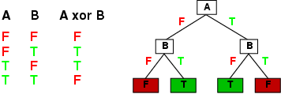
Expressiveness
Decision trees can express any function of the input attributes.
E.g., for Boolean functions, truth table row → path to leaf:
Trivially, there is a consistent decision tree for any training set with one path to leaf for each example (unless f nondeterministic in x) but it probably won't generalize to new examples
Prefer to find more compact decision trees

Slide 26
Hypothesis spaces
How many distinct decision trees with n Boolean attributes?
= number of Boolean functions
= number of distinct truth tables with 2^{n} rows = 2^{2n}
E.g., with 6 Boolean attributes, there are 18,446,744,073,709,551,616 possible trees

Slide 27
Hypothesis spaces
How many distinct decision trees with n Boolean attributes?
= number of Boolean functions
= number of distinct truth tables with 2^{n} rows = 2^{2n}
E.g., with 6 Boolean attributes, there are 18,446,744,073,709,551,616 trees
How many purely conjunctive hypotheses (e.g., Hungry ∧ ¬Rain)?
Each attribute can be in (positive), in (negative), or out
⇒ 3^{n} distinct conjunctive hypotheses
More expressive hypothesis space
increases chance that target function can be expressed
increases number of hypotheses consistent with training set
⇒ may get worse predictions

Slide 28
ID3 Algorithm
A greedy algorithm for decision tree construction developed by Ross Quinlan circa 1987
Top-down construction of decision tree by recursively selecting “best attribute” to use at the current node in tree
Once attribute is selected for current node, generate child nodes, one for each possible value of selected attribute
Partition examples using the possible values of this attribute, and assign these subsets of the examples to the appropriate child node
Repeat for each child node until all examples associated with a node are either all positive or all negative

Slide 29
Choosing the best attribute
Key problem: choosing which attribute to split a given set of examples
Some possibilities are:
Random: Select any attribute at random
Least-Values: Choose the attribute with the smallest number of possible values
Most-Values: Choose the attribute with the largest number of possible values
Max-Gain: Choose the attribute that has the largest expected information gain–i.e., attribute that results in smallest expected size of subtrees rooted at its children
The ID3 algorithm uses the Max-Gain method of selecting the best attribute

Slide 30
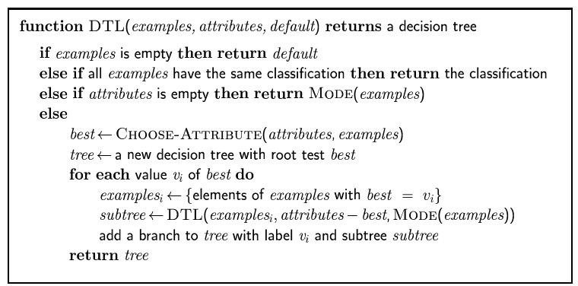
Decision tree learning
Aim: find a small tree consistent with the training examples
Idea: (recursively) choose "most significant" attribute as root of (sub)tree

Slide 31
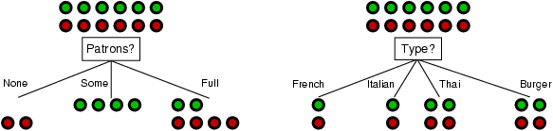
Choosing an attribute
Idea: a good attribute splits the examples into subsets that are (ideally) "all positive" or "all negative"
Patrons? is a better choice

Slide 32
Using information theory
To implement Choose-Attribute in the DTL algorithm
Information Content (Entropy):
I(P(v₁), … , P(v_{n})) = Σ_{i=1} -P(v_{i}) log₂ P(v_{i})
For a training set containing p positive examples and n negative examples:

Slide 33
Information theory 101
Information theory sprang almost fully formed from the seminal work of Claude E. Shannon at Bell Labs
A Mathematical Theory of Communication, Bell System Technical Journal, 1948.
Intuitions
Common words (a, the, dog) are shorter than less common ones (parlimentarian, foreshadowing)
In Morse code, common (probable) letters have shorter encodings
Information is measured in minimum number of bits needed to store or send some information
Wikipedia: The measure of data, known as information entropy, is usually expressed by the average number of bits needed for storage or communication.

Slide 34
Information theory 101
Information is measured in bits
Information conveyed by message depends on its probability
With n equally probable possible messages, the probability p of each is 1/n
Information conveyed by message is -log(p) = log(n)
e.g., with 16 messages, then log(16) = 4 and we need 4 bits to identify/send each message
Given probability distribution for n messages P = (p₁,p₂…p_{n}), the information conveyed by distribution (aka entropy of P) is:
I(P) = -(p₁*log(p₁) + p₂*log(p₂) + .. + p_{n}*log(p_{n}))
probability of msg 2
info in msg 2

Slide 35
Information theory II
Information conveyed by distribution (a.k.a. entropy of P):
I(P) = -(p₁*log(p₁) + p₂*log(p₂) + .. + p_{n}*log(p_{n}))
Examples:
If P is (0.5, 0.5) then I(P) = .5*1 + 0.5*1 = 1
If P is (0.67, 0.33) then I(P) = -(2/3*log(2/3) + 1/3*log(1/3)) = 0.92
If P is (1, 0) then I(P) = 1*1 + 0*log(0) = 0
The more uniform the probability distribution, the greater its information: More information is conveyed by a message telling you which event actually occurred
Entropy is the average number of bits/message needed to represent a stream of messages

Slide 36
Information gain
A chosen attribute A divides the training set E into subsets E₁, … , E_{v} according to their values for A, where A has v distinct values.
Information Gain (IG) or reduction in entropy from the attribute test:
Choose the attribute with the largest IG

Slide 37
Information gain
For the training set, p = n = 6, I(6/12, 6/12) = 1 bit
Consider the attributes Patrons and Type (and others too):
Patrons has the highest IG of all attributes and so is chosen by the DTL algorithm as the root

Slide 38
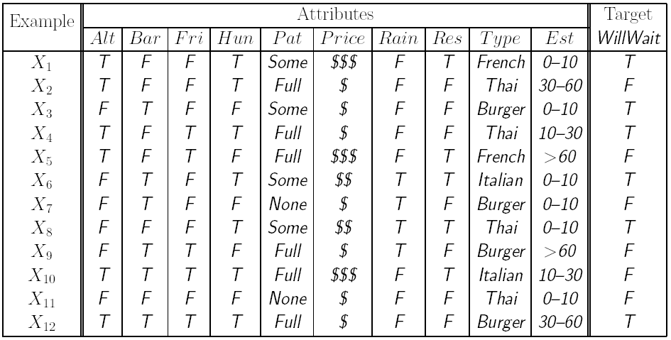
Decision tree learning example
Alternate?
Yes
No
3 T, 3 F
3 T, 3 F
Entropy decrease = 0.30 – 0.30 = 0
NOTE: These examples use ln(.) and not log₂(.) like previous slides
decisions are the same since both logs are linearly related

Slide 39
Decision tree learning example
Bar?
Yes
No
3 T, 3 F
3 T, 3 F
Entropy decrease = 0.30 – 0.30 = 0

Slide 40
Decision tree learning example
Sat/Fri?
Yes
No
2 T, 3 F
4 T, 3 F
Entropy decrease = 0.30 – 0.29 = 0.01

Slide 41
Decision tree learning example
Hungry?
Yes
No
5 T, 2 F
1 T, 4 F
Entropy decrease = 0.30 – 0.24 = 0.06

Slide 42
Decision tree learning example
Raining?
Yes
No
2 T, 2 F
4 T, 4 F
Entropy decrease = 0.30 – 0.30 = 0

Slide 43
Decision tree learning example
Reservation?
Yes
No
3 T, 2 F
3 T, 4 F
Entropy decrease = 0.30 – 0.29 = 0.01

Slide 44
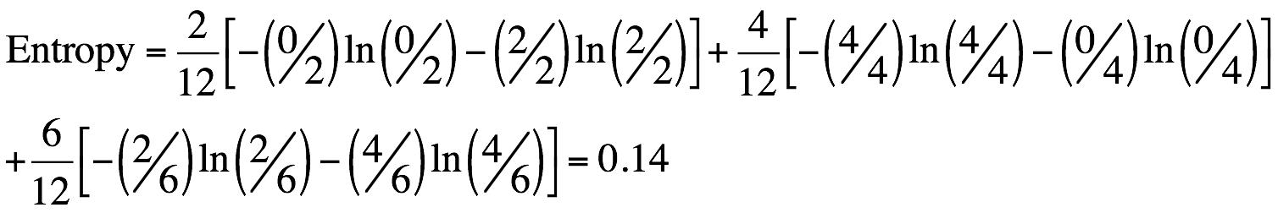
Decision tree learning example
Patrons?
None
Full
2 F
Some
2 T, 4 F
4 T
Entropy decrease = 0.30 – 0.14 = 0.16

Slide 45
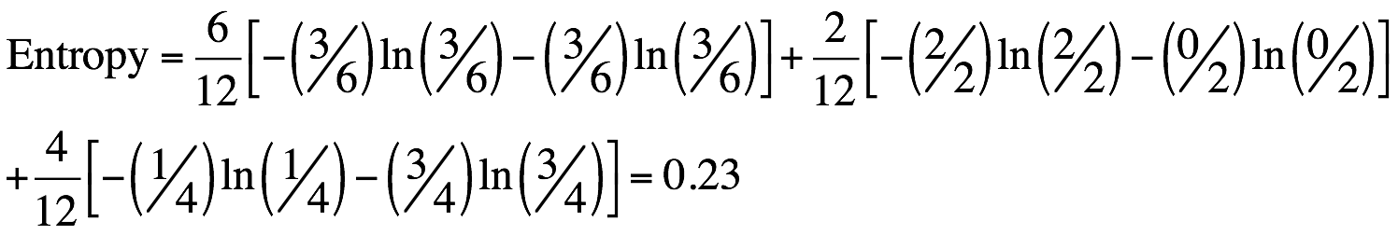
Decision tree learning example
Price
$
$$$
3 T, 3 F
$$
1 T, 3 F
2 T
Entropy decrease = 0.30 – 0.23 = 0.07

Slide 46
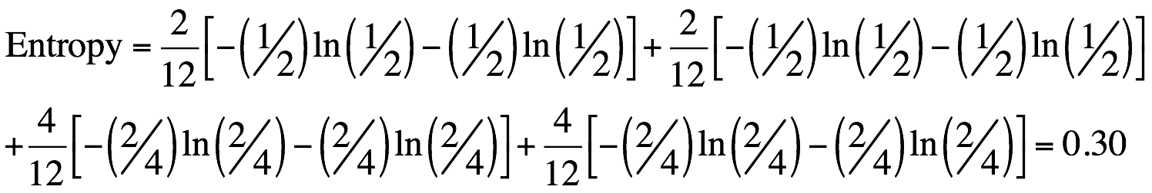
Decision tree learning example
Type
French
Burger
1 T, 1 F
2 T, 2 F
Italian
Thai
1 T, 1 F
2 T, 2 F
Entropy decrease = 0.30 – 0.30 = 0

Slide 47
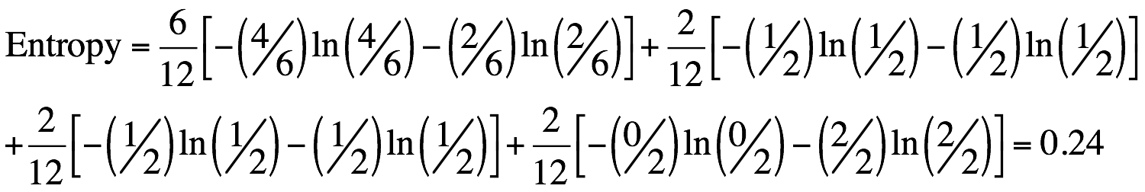
Decision tree learning example
Est. waiting time
0-10
> 60
4 T, 2 F
2 F
10-30
30-60
1 T, 1 F
1 T, 1 F
Entropy decrease = 0.30 – 0.24 = 0.06

Slide 48
Decision tree learning example
Patrons?
Largest entropy decrease (0.16) achieved by splitting on Patrons.
None
Full
2 F
Some
X?
2 T, 4 F
Continue like this, making new splits, always purifying nodes.
4 T

Slide 49
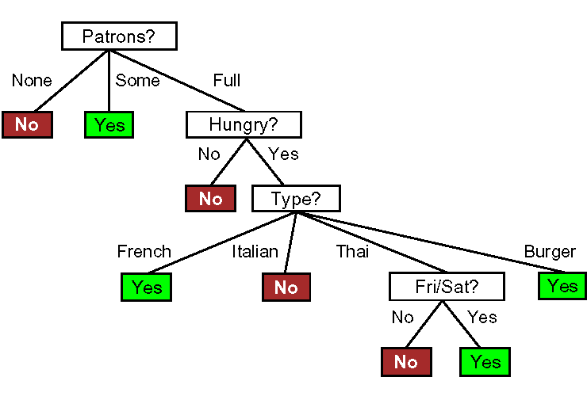
Decision tree learning example
Induced tree (from examples)

Slide 50
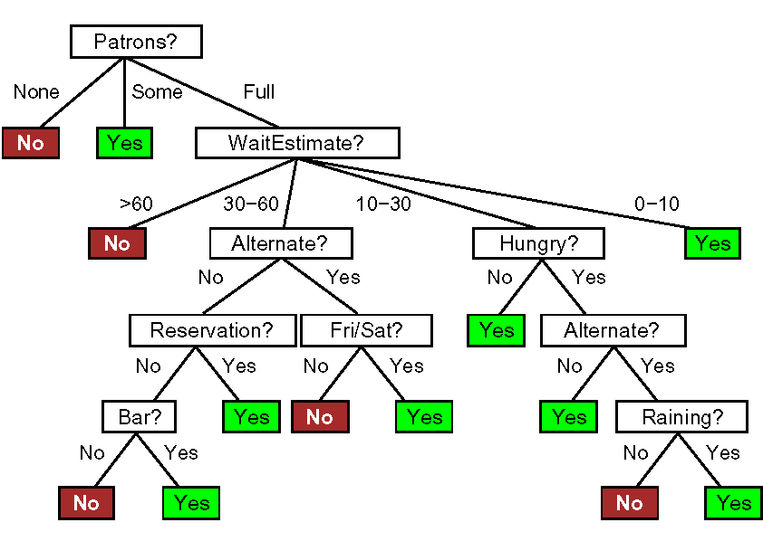
Decision tree learning example
True tree (by hand)

Slide 51
Decision tree learning example
Induced tree (from examples)
Cannot make it more complex than what the data supports.

Slide 52
How do we know it is correct?
How do we know that h ≈ f ? (Hume's Problem of Induction)
Try h on a new test set of examples (cross validation)
...and assume the ”principle of uniformity”, i.e. the result we get on this test data should be indicative of results on future data. Causality is constant.
Inspired by a slide by V. Pavlovic

Slide 53
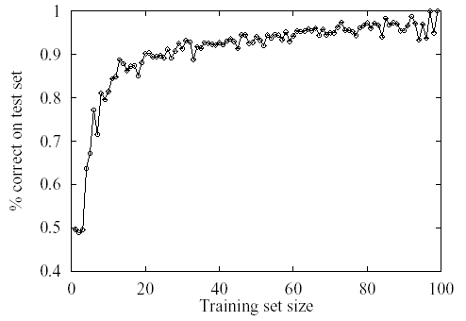
Learning curve for the decision tree algorithm on 100 randomly generated examples in the restaurant domain.
The graph summarizes 20 trials.

Slide 54
Cross-validation
Use a “validation set”.
Split your data set into two
parts, one for training your
model and the other for
validating your model.
The error on the validation
data is called “validation error”
(E_{val})
D_{train}
D_{val}
E_{val}

Slide 55
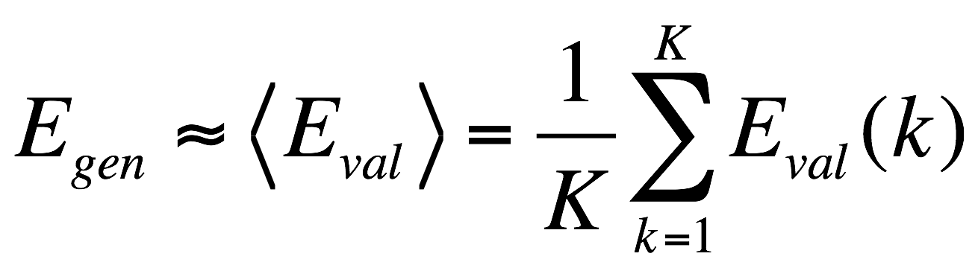
K-Fold Cross-validation
More accurate than using only one validation set.
D_{train}
D_{val}
D_{train}
D_{val}
D_{train}
D_{val}
D_{train}
E_{val}(1)
E_{val}(2)
E_{val}(3)

Slide 56
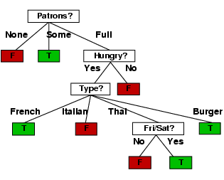
Example contd.
Decision tree learned from the 12 examples:
Substantially simpler than “true” tree---a more complex hypothesis isn’t justified by small amount of data

Slide 57
Summary
Learning needed for unknown environments, lazy designers
Learning agent = performance element + learning element
For supervised learning, the aim is to find a simple hypothesis approximately consistent with training examples
Decision tree learning using information gain
Learning performance = prediction accuracy measured on test set

